Slide 1
Introducción a Preprocesamiento de Texto

Slide 2
Niveles de representación texto
Tres niveles
Léxico:
caracteres,
palabras,
frases, y
partes del habla (part of speech)
Sintáctico:
modelado de espacio de vectores
transformación de texto puro a un texto preprocesado en el formato de una matriz de términos en documentos
modelo de lenguaje
distribución probabilística de una secuencia de palabras
análisis completo (full-parsing)
representación de una frase con un árbol de análisis sintáctico.

Slide 3
Niveles de representación texto
Tres niveles
Semántico
etiquetado colaborativo, y
ontologías

Slide 4
Nivel Léxico: caracteres
Caracteres se clasifican en letras y delimitadores.
Tokens: secuencia de caracteres de letras entre delimitadores.
Caracteres tienen una función muy importante en el etiquetado de parte del habla (POS) y el reconocimiento de entidades
Áreas de aplicación
corrector ortográfico, clasificación de la segmentación de palabras, y más.

Slide 5
Nivel léxico: palabras
Es la representación de texto más común en muchas técnicas de minería de texto.
… casi todos los paquetes de minería de texto se incluyen una función de tokenización que separa el texto en palabras.
Importante conocer
Una palabra es una unidad bien definida en los lenguajes occidentales,…
pero el Chino, por ejemplo, tiene otras nociones de unidad semántica.

Slide 6
Definiciones
Text: “to sleep perchance to dream”
Token
una instancia de una palabra o un término que aparece en un documento
Examples: “to” , “sleep” , “perchance” , “to” , “dream”
Type
es lo mismo que un término en la mayoría de los casos.
la clase de todos los tokens que contienen la misma secuencia de caracteres
Examples: “to” , “sleep” , “perchance” , “dream”
Term
una palabra normalizada según su morfología, ortografía, etc.
es un tipo (tal vez normalizado) que es incluido en el diccionario del sistema IR
Example: “sleep” , “perchance” , “dream”

Slide 7
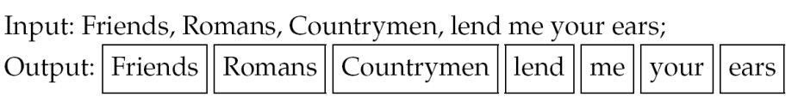
Tokenization
Given a character sequence and a defined document unit, tokenization is the task of chopping it up into pieces, called tokens, perhaps at the same time throwing away certain characters, such as punctuation

Slide 8
Specific Tokens
C++, C#
B-52, B777
M*A*S*H
Email addresses (cmpt456@sfu.ca)
Web URLs (http://www.cs.sfu.ca)
IP addresses (142.32.48.231)
Phone number (778-782-3054)
City names (San Francisco, New York)

Slide 9
Problems of tokenization
Definition of Token
United States, AT&T, 3-year-old
Ambiguity of punctuation as sentence boundary
Prof. Dr. J.M.
Ambiguity in numbers
123,456.78

Slide 10
Some Solutions
Using regular expressions to match numbers and abbreviations
([0-9]+[,])*[0-9]([.][0-9]+)?
[A-Z][bcdfghj-np-tvxz]+\.
Using corpus as a filter to identify abbreviations
Using a lexical list (most important abbreviations are listed)

Slide 11
Word Segmentation
In some languages (e.g., Chinese), text is written without any spaces between words
信息检索和Web搜索是一门很有意思的课程。
Word segmentation methods
Use a large vocabulary and take the longest vocabulary match
Machine learning sequence models (e.g., Markov models, conditional random fields)
Character k-grams

Slide 12
Stop Words
Some extremely common words that would appear to be of little value in helping select documents matching a user need are excluded from the vocabulary entirely
Determined by collection frequency – the total number of times each term appears in the document collection

Slide 13
Token Normalization
How can we know USA matches U.S.A?
Token normalization is the process of canonicalizing tokens so that matches occur despite superficial differences in the character sequences of the tokens

Slide 14
Normalization Techniques
Accents and diacritics
Normalizing tokens to remove diacritics
Capitalization/case-folding
Reducing all letters to lower case
May cause problems for names such as Bush, Black, Fed, …
– Use some heuristics to make some tokens lowercase, e.g., convert the first word in a sentence, all words in a title
– Truecasing: use a machine learning sequence model to make the decision

Slide 15
Stemming and Lemmatization
How can we know “organize” , “organizes”, and “organizing” should map to the same word?
Stemming and lemmatization: reduce inflectional forms and sometimes derivationally related forms of a word to a common base form
am, are, is → be
car, cars, car’s, cars’ → car
“the boy’s cars are different colors” → “the boy car be different color”

Slide 16
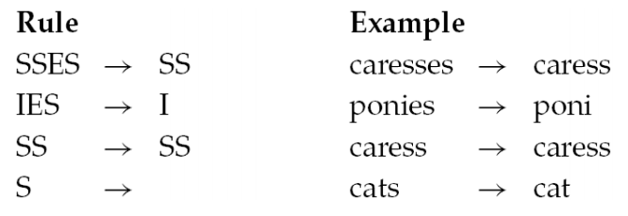
Stemming
Algorithmic: a crude heuristic process that chops off the ends of words in the hope of being correct most of the time
– Often remove derivational affixes
Porter’s algorithm hope of being correct most of the time

Slide 17
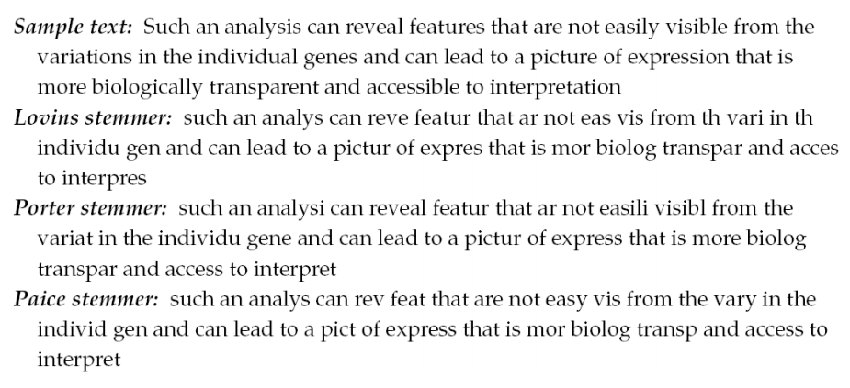
Comparison of Stemmers

Slide 18
Lemmatization
Dictionary-based stemming
Use a vocabulary and morphological analysis of words to remove inflectional endings only and return the base or dictionary form of a word (lemma)
“ saw ” → “ see ” or “ saw ” depending on whether the token is used as a verb or a noun
Can bring very modest benefit for retrieval in English – improving recall but may hurt accuracy

Slide 19
Krovetz Stemmer – A Hybrid Method
A hybrid approach
Constantly using a dictionary to check if a word is valid
– If a word is not found, check the word against a list of common inflectional and derivational suffixes, modify the word and check the dictionary again
• Using manually generated exception entries to record special stemming processing rules
• Low false positive rate, but tends to a high false negative rate
• Producing stems that, in most cases, are full words

Slide 20
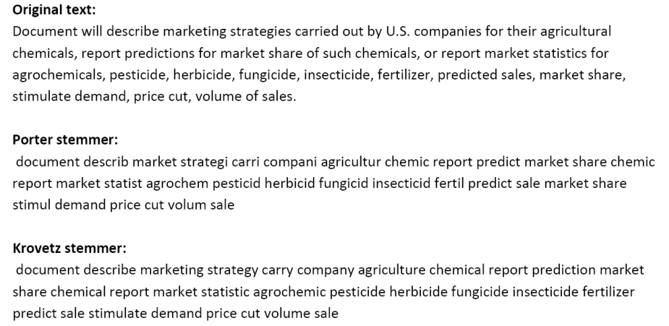
Comparison

